Slide 1
Final Presentation
By: Nidhi Anilnath, Milan Patel, Timothy Perry, Seung Wan Jung

Slide 2


Introduction
GT Student Perspective
On Engagement and Mental Health
During the COVID-19 Pandemic
Work with Dr. Weinsheimer and Center for Teaching & Learning
Instructors are struggling to find reliable feedback from students on the efficacy of their online instruction and barriers to engagement
Unable to identify relationship between course delivery mode during COVID-19 pandemic and students’ mental health
Notes:
Ctl- tim

Slide 3
Literature Review - COVID-19 and the Learning Environment
Externalizing problems, such as attention problems, and internalizing problems, such as emotional problems, were reported to be higher after the onset of COVID-19. (Copeland et al., 2021)
Students are more anxious and depressed after introduction to remote learning environment. (Horita, Nishio, & Yamamoto, 2020)
However, before the pandemic, hybrid learning format showed the highest learning scores and course satisfaction. (Chen & Chiou, 2012)
First year students were impacted more drastically by the pandemic than other years. (Horita, Nishio, & Yamamoto, 2020)
Peer leadership experience and classroom engagement is good predictor of students’ mental health. (Young, Hoffman, & Frakes Reinhardt, 2019)
Notes:
seung

Slide 4



Literature Synthesis
Students’ engagement in school activities and classroom settings are important factors of academic well-being.
Remote learning may have been effective when optional, but rather have detrimental effect to mental health when remote learning is required.
Various learning environments may be moderated by participant’s year in college.
Notes:
seung

Slide 5
Research Question
Research Questions
How does remote learning environment in Georgia Tech affect students’ engagement and mental health?
How do underclassmen and upperclassmen differ in their reaction to remote learning?
Notes:
Statement of Gap in the literature- The literature overlooks to what amount of online vs in person learning have on academic wellbeing and levels of student engagement. The literature overlooks differences in academic experience (i.e freshman vs senior etc.)

Slide 6
Hypotheses
Hypotheses
This relationship will be moderated by academic year where first-year students are more affected in comparison to other years.
Students with more time spent in person would report lower levels of depression, anxiety, and stress.
Students with more time spent in person would report higher levels of engagement.

Slide 7
Variables
Variable Type | Variable | Definition
Independent Variable | Course Model (in-person, hybrid, synchronous virtual, or asynchronous virtual) | Hours spent in-person vs. synchronous virtual, vs. asynchronous virtual
Dependent Variable | Indicators of Mental Health | DASS21 Scale Score → Depression, Anxiety, Stress
Dependent Variable | Student Engagement | EPIC Scale Score → students’ adherence to active learning activities
Moderator | Academic Experience | Year in College (Undergraduates only)
Notes:
Tim

Slide 8


Method- Participants
Recruitment Strategy
Register study with Psychology SONA
Distribute through sponsor’s faculty mailing list
Population: Georgia Tech undergraduate student body
Current Sample: 456 students
Inclusion Criterion
Must be taking classes in Spring 2021
Exclusion Criterion
Pass all attention checks
Complete full survey
Notes:
nidhi

Slide 9
Methods- Materials
Our study used a Qualtrics Survey to collect data
The survey contained:
Demographic items
Questions about the amount of class time spent virtually/in-person
Items from the DASS21 (depression, anxiety, stress scale)
Items from the EPIC scale (student engagement)
Reverse coded questions and attention checks
Survey was distributed via email and participants responded from their personal electronic devices
Notes:
milan

Slide 10
Methods- Procedure
All potential participants received an informed consent.
Upon signing this, they were given a 15-20 minute electronic Qualtrics survey to complete.
The data we collected was cleaned and then we conducted a one-way ANOVA.
Checked for age as a moderator variable
Notes:
nidhi

Slide 11
Results - Data Cleaning & Descriptive Stats
Load data from Qualtrics survey using spss format (.sav)
Load ‘haven’, ‘dplyr’, and ‘tidyverse’ package
Delete data of participants who didn’t fulfill the requirements
Those who didn’t pass the attention check for the survey
Those who didn’t complete all required fields of the survey
Calculate EPIC and DASS scale
Replace reverse-coded questions with actual value
Sum the scores of the respective questionnaires
Set variables and rewrite them back to dataframe as a factor
Notes:
Make sure to describe what the attention checks were and what factors that you wrote the variables as

Slide 12
Results - Descriptive Statistics

Slide 13
Results - Analyses used for hypothesis testing
Rationale for hours as a categorical variable rather than continuous
One-way ANOVA tests to check significant differences between hours in different classroom environment and scores in DASS & EPIC scale
In-person, Synchronous, Asynchronous vs EPIC, DASS scores (6 ANOVA tests)
No significant results found from all 6 ANOVA tests
Check academic year as a moderator variable
Centering predictors (academic year, course delivery mode)
Hierarchical regression
Age was not a moderator variable for all 3 types of course delivery mode
Notes:
Using a categorical variable for time is easier for participants to fill out
Participants quantify time in chunks
We also didn’t expect to see any difference between each hour

Slide 14
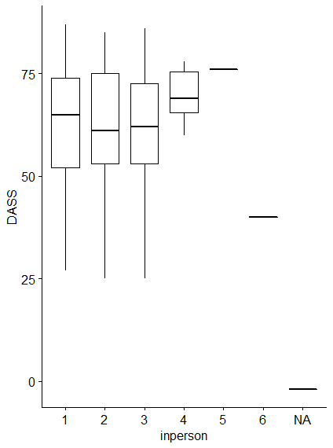
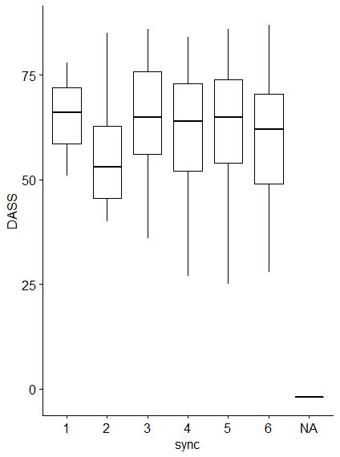
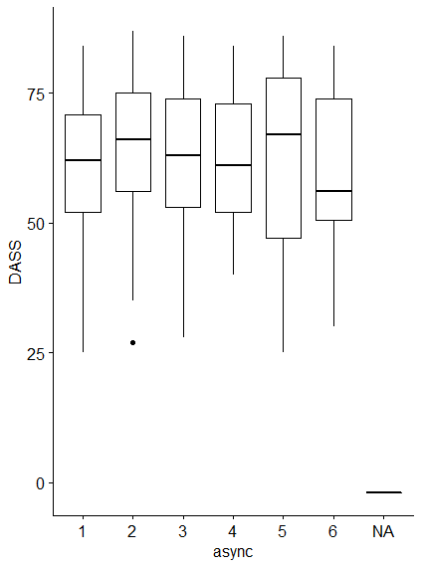
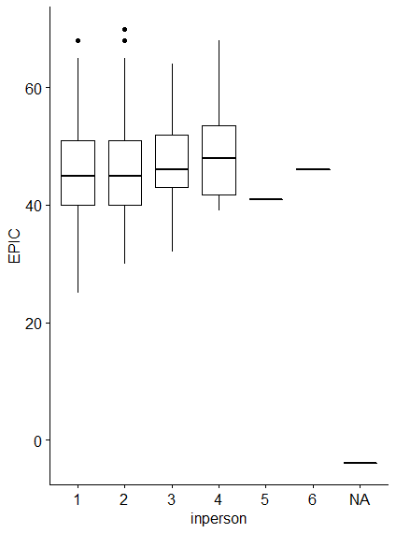
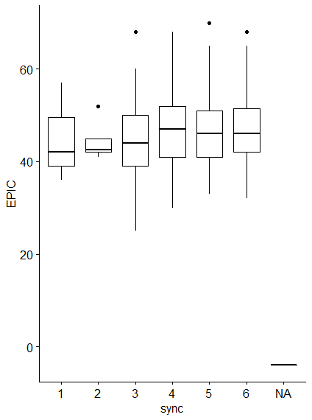
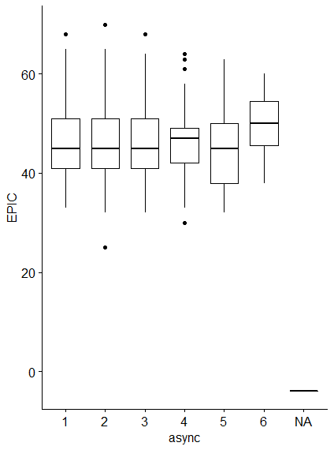
Results visualization
P-value: 0.337
P-value: 0.192
P-value: 0.329
P-value: 0.467
P-value: 0.395
P-value: 0.613
N=1
N=1
N=8
N=94
N=89
N=116
N=87
N=82
N=79
N=6
N=3
N=197
N=113
N=93
N=139
N=37
N=31
N=15

Slide 15
Interpreting the Results
Relating to Hypothesis
No effect of course mode on student engagement
No effect of course mode on indicators of mental health (depression, anxiety, stress)
No interaction effect of course mode and academic experience
Supplemental Analysis
Higher mean score for questions with positive valence
Large variance of score across all items in DASS21 scale
Generally negative EPIC scale scores
Notes:
Not able to compare traditional learning (in person) to online (aynch, synch)
May suggest online instruction impacted each academic year similarly, academic experience
Some response bias; students more restrained/aprehensive in their answering questions of negative valence
May suggest a more complex picture of mental health than what was observed in this study
May be due to specificity of engagement activities

Slide 16
Limitations and future considerations
Not enough participants with in-person hours
Georgia Tech culture is much more rigorous
Cross Sectional Design
Notes:
This limited sample size could have contributed heavily to the lack of significant results, since the groups that were compared were too small
When compared to other schools, such as those in previous literature, GT is known to have much more intense academic rigor
This could have lead to a higher baseline for depression, anxiety, stress, and student engagement, which could be another factor for why no significant results were observed
Observing indicators of mental health at one time does not capture the plasticity of student affect
Time of observation during midterms

Slide 17
References
Chen, B., & Chiou, H. (2012, January 30). Learning style, sense of community and learning effectiveness in hybrid learning environment. Retrieved January 30, 2021, from https://www.tandfonline.com/doi/ref/10.1080/10494820.2012.680971?scroll=top
Copeland, W. E., McGinnis, E., Bai, Y., Adams, Z., Nardone, H., Devadanam, V., Rettew, J., & Hudziak, J. J. (2021). Impact of COVID-19 Pandemic on College Student Mental Health and Wellness.Seipp, B. (1991). Anxiety and academic performance: A meta-analysis of findings. Anxiety Research, 4(1), 27-41.
Horita, R., Nishio, A., & Yamamoto, M. (2020). The Effect of Remote Learning on the Mental Health of First Year University Students in Japan. Psychiatry Research, 295. https://doi.org/10.1016/j.psychres.2020.113561
Iorga, M., Dondas, C., & Zugun-Eloae, C. (2018). Depressed as Freshmen, Stressed as Seniors: The Relationship between Depression, Perceived Stress and Academic Results among Medical Students. Behavioral sciences (Basel, Switzerland), 8(8), 70. https://doi.org/10.3390/bs8080070
Musulkin, S., &amp; Bhattacharya, G. (2010). Role of Student–Faculty Interactions in Developing College Students’ Academic Self-Concept, Motivation, and Achievement. Journal of College Student Development, 51(3), 332-342. doi:/10.1353/csd.0.0137
Tran, T. D., Tran, T., & Fisher, J. (2013). Validation of the depression anxiety stress scales (DASS) 21 as a screening instrument for depression and anxiety in a rural community-based cohort of northern Vietnamese women. BMC psychiatry, 13(1), 1-7.
UNDERGRADUATE STUDENT Reference Group Data Report Fall 2018. (n.d.). Retrieved from https://www.acha.org/documents/ncha/NCHA-II_Fall_2018_Undergraduate_Reference_Group_Data_Report.pdf.
Young, D. G., Hoffman, D. E., & Frakes Reinhardt, S. (2019). An exploration of the connection between participation in academic peer leadership experiences and academic success. Journal of Peer learning, 12(1), 45-60.
Notes:
milan

Slide 18
Timeline
Date | Check Point
1/26/21 | Team Contract
2/2/21 | Literature Review Update
2/9/21 | Literature Synthesis
2/23/21 | Research Plan (Paper)
2/23/21 | Research Plan (Presentation)
2/23/21 | Team Evaluation 1 (with Research Plan)
3/16/21 | Complete Data
Date | Check Point
3/23/21 | Initial Findings (Paper)
3/23/21 | Initial Findings (Presentation)
3/23/21 | Team Evaluation 2 (with Initial Findings)
4/27/21 | Final Project (Paper)
4/27/21 | Final Project (Presentation)
4/27/21 | Team Evaluation 3 (with Final Project)
Notes:
nidhi

Slide 19
Budget
Budget Proposal ($300) total | $100 Psych Department | $200 Center for Teaching/ Learning | Additional Funds
Participation Incentive cost | $0 | $0 | $0
Survey Scales/Literature Resources cost | $0 | $0 | $0
Technology Expenses cost | $0 | $0 | $0
Although we have a budget of $300 ($100 from the Psych Department and $200 from the Center for Teaching/ Learning), we will not be using any of this funding. As Qualtrics is a free platform, we will not need to spend any of the budget on creating or distributing the survey.
Notes:
nidhi

Slide 20
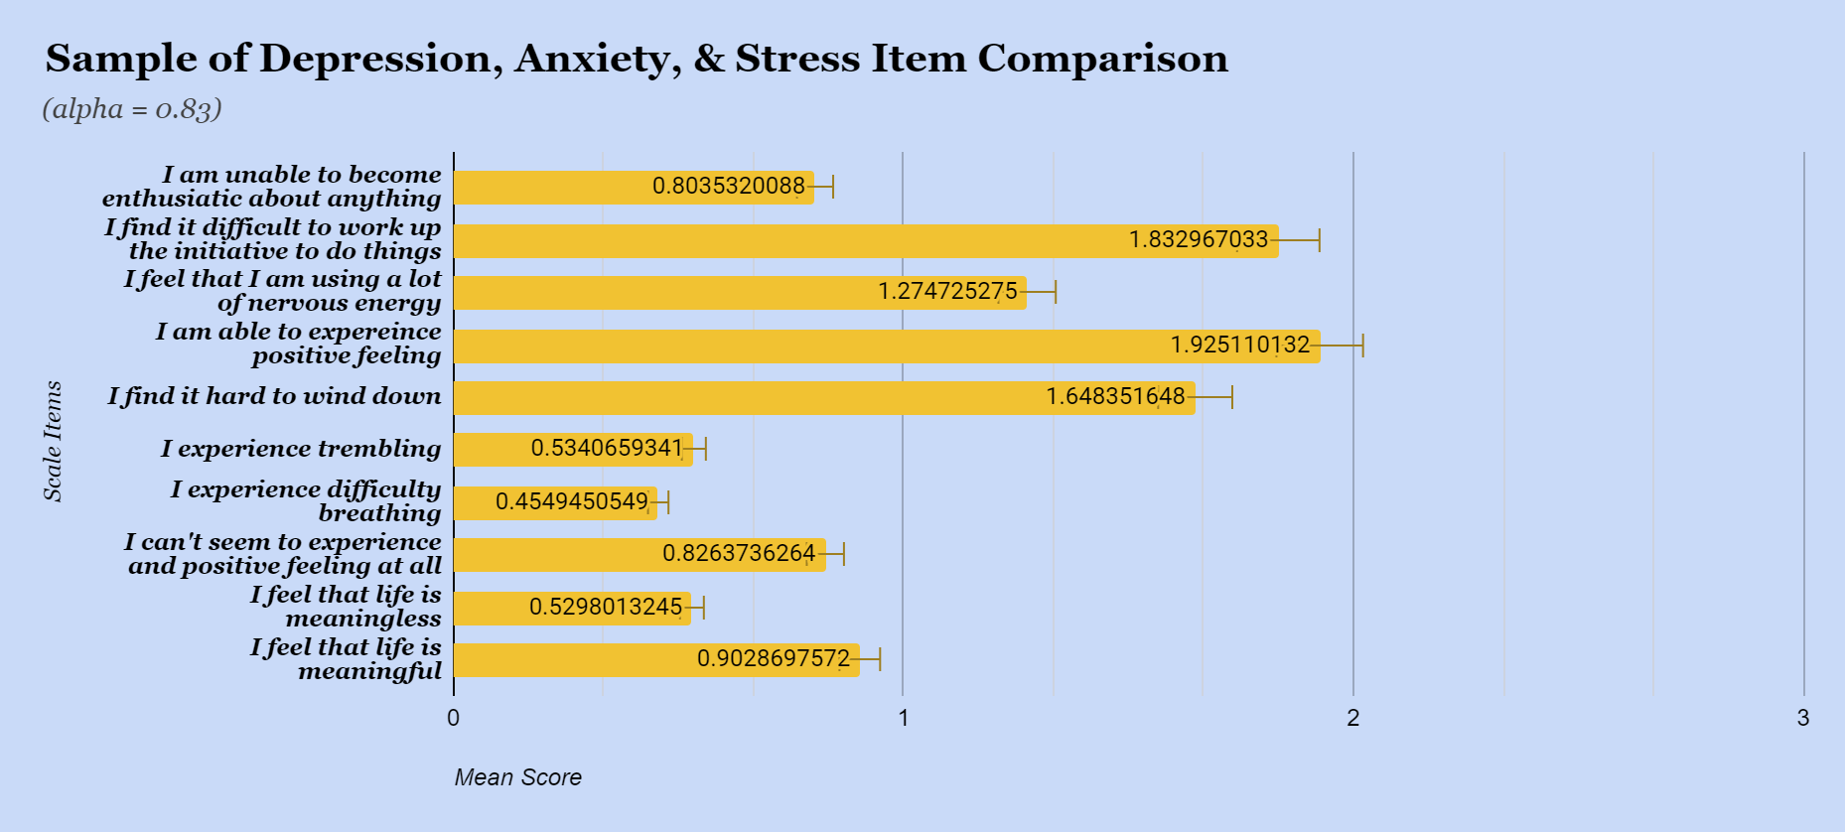
Supplemental Analysis
4-item scale
3: Applies to me very much 2: Applies to me a considerable degree 1: Applies to me some degree 0: Does not Apply to me at all

Slide 21
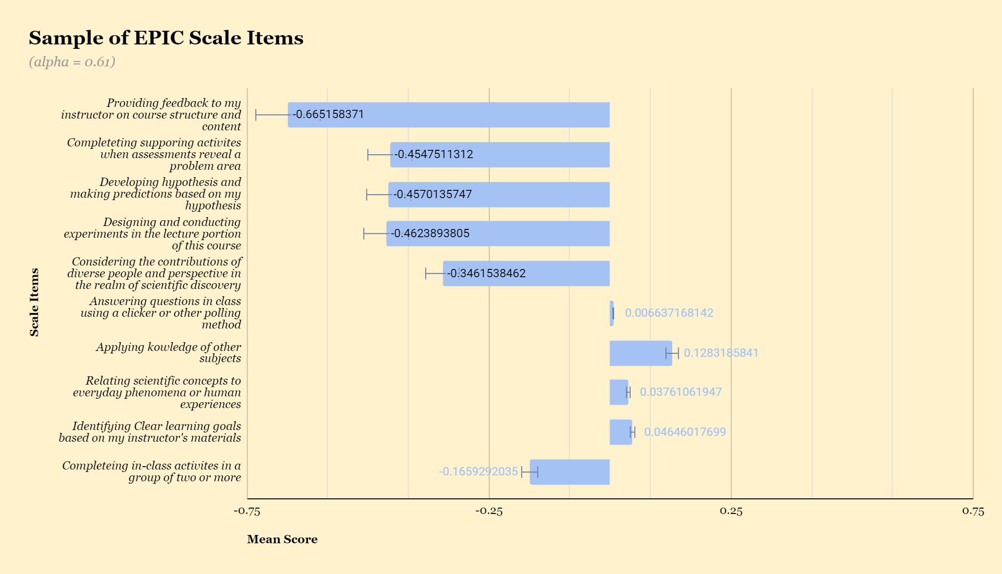
Supplemental Analysis
5-Item Likert Scale
-2: I think it happened once -1: Happens Sometimes 0: Did not happen for any of my classes 1: Happens Often: 2 Every single class session

